Slide 1
Introduction to Soft Computing
Dr. Arpita Dutta
Assistant Professor
CSE – AI & ML
Techno Main Salt Lake, Kolkata

Slide 2
Soft Computing : Definition
Soft Computing is an emerging approach to computing which parallel the remarkable ability of the human mind to reason and learn in a environment of uncertainty and imprecision (Lotfi A. Zadeh, 1992).
It refers to a group of computational techniques that are based on artificial intelligence (AI) and natural selection.
It provides cost-effective solutions to the complex real-life problems for which hard computing solution does not exist.
The objective of soft computing is to provide precise approximation and quick solutions for complex reallife problems.

Slide 3
Fuzzy Logic
The father of fuzzy logic is Lotfi Zadeh who is still there, proposed in 1965. Fuzzy logic can manipulate those kinds of data which are imprecise.
The word fuzzy means that, in general sense when we talk about the real world, our expression of the real world, the way we quantify the real world, the way we describe the real world, are not very precise.
Example : what the temperature is today? The normal answer people would give is, today it is very hot or hot or cool. Our expression about the world around us is always not precise. Not to be precise is exactly what is fuzzy.
Since we deal with our world with this imprecise way, naturally, the computation that involves the logic of impreciseness is much more powerful than the computation that is being carried through a precise manner, or rather precision logic based computation is inferior; not always, but in many applications, they are very inferior in terms of technological application in our day to day benefits, the normal way.

Slide 4
Fuzzy Sets
Difference in Fuzzy and crisp boundary

Slide 5
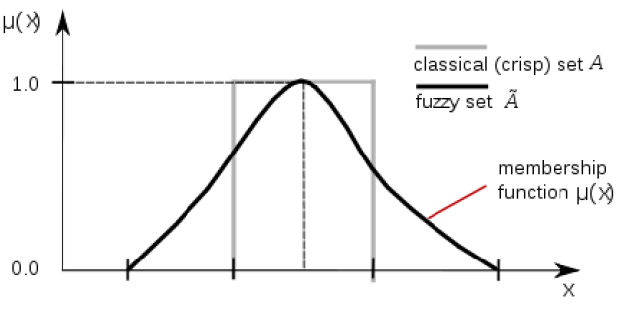
Sets: classical & fuzzy boundary
Set: A collection of objects having one or more common characteristics. For example, set of natural number, set of real numbers, members, or elements. Objects belonging to a set is represented as x belonging to A, where A is a set.
Universe of Discourse: Defined as “a collection of objects all having the same characteristics”.
Notation: U or X, and elements in the universe of discourse are: u or x

Slide 6
Membership Function
A membership function μA(x) is characterized by μA that maps all the members in set x to a number between 0 to 1, where x is a real number describing an object or its attribute, X is the universe of discourse and A is a subset of X.
Example : Fuzzy Sets with Discrete Universes, Fuzzy set A = “sensible number of children”
X = {0, 1, 2, 3, 4, 5, 6} (discrete universe) A = {(0, .1), (1, .3), (2, .7), (3, 1), (4, .6), (5, .2), (6, .1)}

Slide 7
Membership Function
Fuzzy Set with continuous universe
Fuzzy set B = “about 50 years old” X = Set of positive real numbers (continuous), B = {(x, μB(x)) | x in X}, μB(x) = f(x)
The function is subjective

Slide 8
Membership Function
Linguistic variable and linguistic values:
Linguistic variable is a variable expressed in linguistic terms e.g. “Age” that assumes various linguistic values like :middleaged, young, old. The linguistic variables are characterized by membership functions.

Slide 9
Membership Functions : Features
Support:
Support of a fuzzy set A is the set of all points x in X such that μA(x) > 0.
Support (A) = {x| μA(x) > 0}
Core:
The Core of a fuzzy set A is the set of all poits x in X such that μA(x) = 1
Core (A) = {x| μA(x) =1}
Normality:
A fuzzy set A is normal if its core is nonempty. Always there is at least one x with μA(x) = 1
then it is normal.

Slide 10
Membership Functions : Features
Crossover point:
A cross over point in fuzzy set A is the x with μA(x) = 0.5
Crossover (A)= {x| μA(x) = 0.5}
Bandwidth:
For a normal & convex fuzzy set
Width(A) =|x2 - x1|, where x2 & x1 are crossover points.
Fuzzy Singleton:
A fuzzy set whose support is a single point in X with μA(x) = 1 is called a fuzzy singleton.

Slide 11
Fuzzy to Crisp conversions: Cuts for fuzzy sets
So, now support and core can be defined as =>

Slide 12
Properties of Fuzzy Sets : Convexity

Slide 13
Properties of Fuzzy Sets : Symmetry
Symmetry:
A fuzzy set is symmetric if its Membership Function is symmetric about a certain point x = c such that,
μA(c+x) = μA(c-x) for all x in X

Slide 14
Membership Functions : Forms and Boundaries
1. Triangular
Where a<b<c & that are x coordinates of the corners of triangular Membership Function

Slide 15
Membership Functions : Forms and Boundaries
2. Trapezoidal
Where a<b<c<d & that are x coordinates of the corners of trapezoidal Membership Function

Slide 16
Membership Functions : Forms and Boundaries
3. Generalized Bell
Where c is the Centre and a is adjusted to vary the width of Membership Function, b controls slope at crossover points.
Bell membership function is also termed as Cauchy Membership Function.

Slide 17
Membership Functions : Forms and Boundaries
4. Gaussian
Where c is the Centre and σ is the width of Membership Function.
5. Left-Right Membership Function:

Slide 18
Membership Functions : Forms and Boundaries
Sigmoidal Membership Function:
It can be open left or open right depending on sign of a.

Slide 19
Membership functions Plotting
Membership functions a. Triangle b. Trapezoidal c. Gaussian d. Bell

Slide 20
Membership functions Plotting
Left and Right Membership Function

Slide 21
Fuzzy Set Operations
The main features of operation on fuzzy set are that unlike conventional sets, operations on fuzzy sets are usually described with reference to membership function.
Operations on fuzzy sets manipulate the membership of the members in a set; members are not manipulated, rather the membership function of the member is manipulated.
However, in classical set what is manipulated is x.
Therefore, any kind of manipulation in fuzzy set does not involve with the element x; rather it involves with its membership function μ(x).

Slide 22
Fuzzy Set Operations
Containment or subset:
Three common fuzzy set operations:
(1) Intersection (Minimum function)
(2) Union, (Maximum function)
(3) Fuzzy Complementation

Slide 23
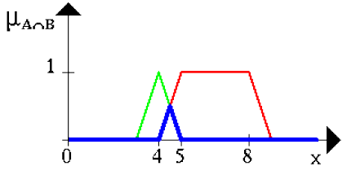
Fuzzy Set Operations
Intersection (Conjunction) or T-norm:
There are 2 sets. One is set A and the other is set B. Apart from seeing the common members, their membership functions are also observed.
The membership function is computed minimum; that is, μ(A ∩ B) is the minimum of μA(x) and μB(x). That is the membership function. When there is a common member between A and B, the membership function wherever is minimum that is retained and the other one is thrown away. The member is retained; what is changing is the membership function.

Slide 24
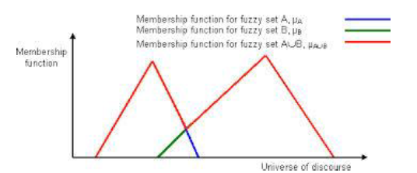
Fuzzy Set Operations
Union(Disjunction) or T-co-norm or S-norm :

Slide 25
Fuzzy Set Operations
Complement (Negation) :

Slide 26
Formal definition in Fuzzy Set
EMPTY SET :
A is EMPTY iff for all x, μA(x) = 0.0.
Equal Set :
A = B iff for all x: μA(x) = μB(x) [or, μA = μB].
Degree (Grade) of membership :
A fuzzy set A in X is characterized by a membership function mA(x) which maps each point in X onto the real interval [0.0, 1.0]. As mA(x) approaches 1.0, the "grade of membership" of x in A increases.

